Slide 1
Prepared by: Yazdaan Khan
End-to-End Retail Performance & Behavioral Analytics RetailNova Inc.
Insights for Policymakers

Slide 2
Rapid online growth;
recent increase in returns and localized profit pressure.
Goals:
identify trends, segment customers, optimize product/inventory, improve store profitability.
Business
Context & Goals

Slide 3
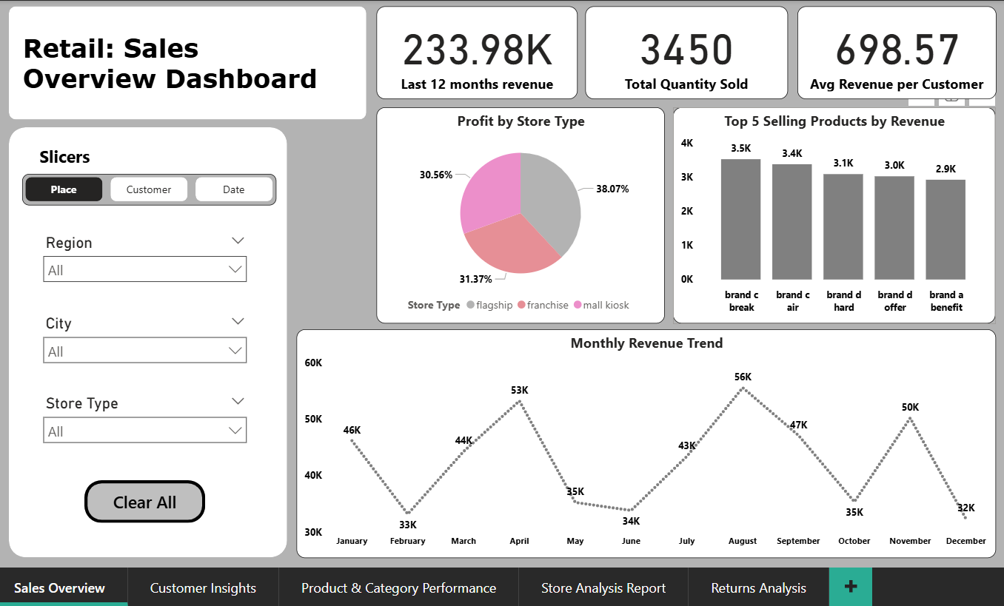
Snapshot (Last 12 months)
Content: Quick orientation to top-line performance.
Total Revenue: 233.98K
Total Quantity Sold: 3,450
ARPC: 698.57

Slide 4
Monthly Revenue Trend
Content: Highlight seasonality and proposed action.
Lowest Month:
Peak Month:
December – 32,337.28
August -- 55,559.24
Action: Investigate August drivers (promotions/events) and plan to replicate.

Slide 5
Top 5 Products
Action: Prioritize inventory & bundle offers for these SKUs.
Brand C Break - 3.5K
Brand C Air - 3.4K
Brand D Hard - 3.1K
Brand D Offer - 3.0K
Brand A Benefit - 2.9K

Slide 6
Profit by Store Type
Content: Suggest cross-store best practice replication.
Kiosk
Franchise
30.56%
Flagship
31.37%
38.07% of profit
Action: Invest in flagship strategies; evaluate kiosk efficiency.

Slide 7
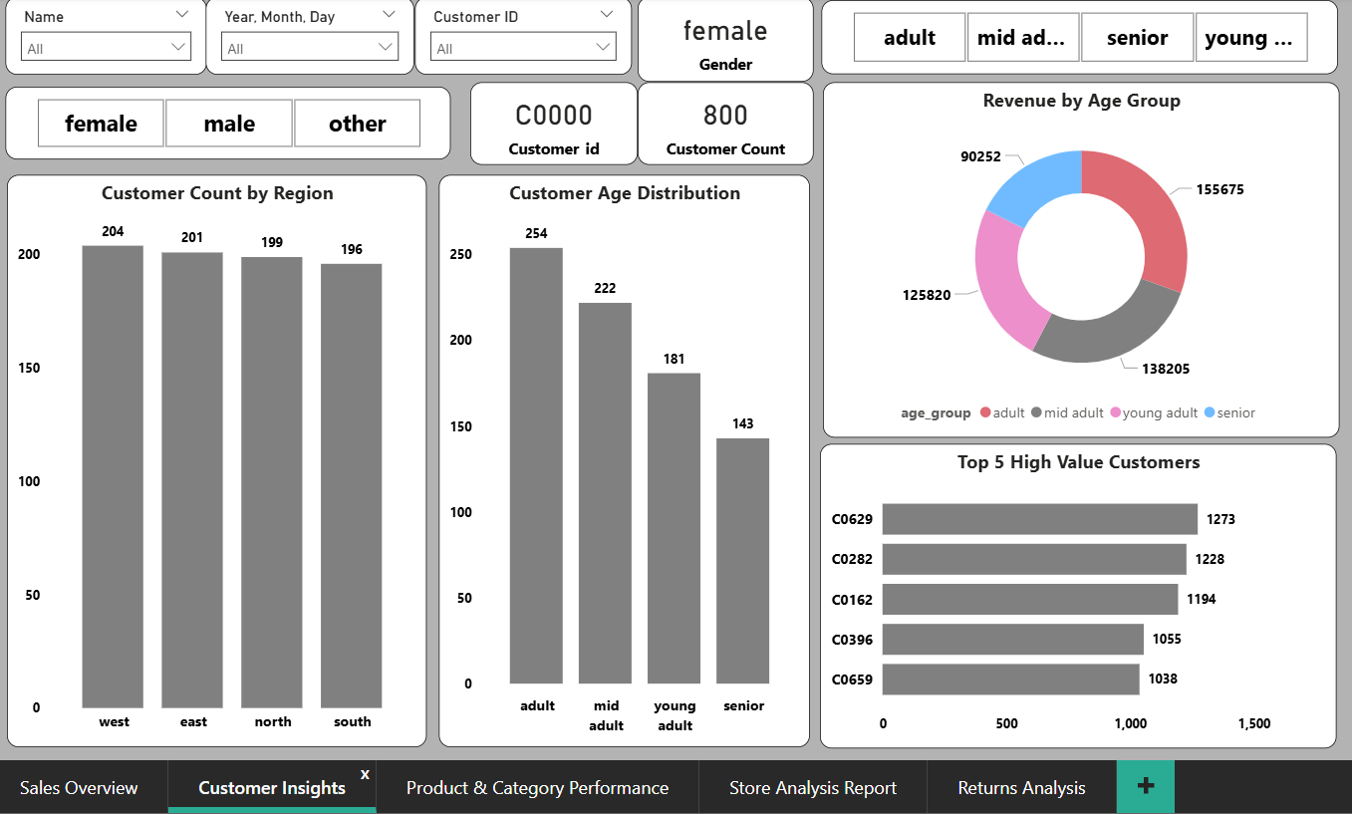
Customer Insights
Male
275
01
Total Customers
800
02
Female
287
03
Top 3 Customers ID
C0629, C0282, C0162
04
Others
238
05

Slide 8
Product Performance (Profit & Returns)
Best category by profit: Personal Care — 52,291
Weak/low profit category: Home & Kitchen —
47,142
Peak return rate month: August — 0.84%
Top return categories: Personal Care (38), Home & Kitchen (33)
Highest return rate: Personal Care — 6.97%
Main reason: Defective — 30.88%
Action:
QC for Personal Care; review Home & Kitchen assortment/pricing.
Action: supplier QA, packaging improvements, training for returns triage.

Slide 9
Recommendations
Quick Wins (0–30 days)
QC audit on Personal Care SKUs; reduce defective returns.
Targeted promotions for Adults & Mid-adults; focus on Top-5 products.
Mall kiosk cost optimization.
Strategic (1–3 quarters)
Scale flagship best practices, rebalance Home & Kitchen SKUs, build CLV program.

Slide 10
Questions & Answers
Thank you for your attention! Feel free to ask any questions.
Presentation by: Yazdaan Khan

